Slide 1
It’s All About the
Money, Money, Money:
Best Practices for Building the Damages Case
Presentation to:
Arent Fox Commercial Litigation Group
By:
Martin Cunniff (Arent Fox)
Kris Boushie (Stout/Risius/Ross
David Paris (Stout/Risius/Ross)
March 12, 2014

Slide 2
Importance of the Damages Case
Very important to client
Informs decision to pursue or settle case
Helps to determine appropriate level of effort
Can effectively decide the case

Slide 3
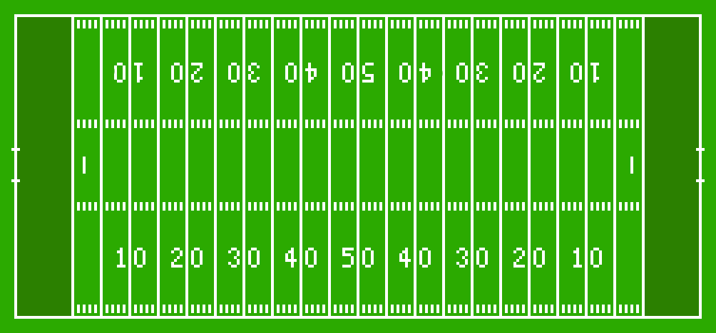

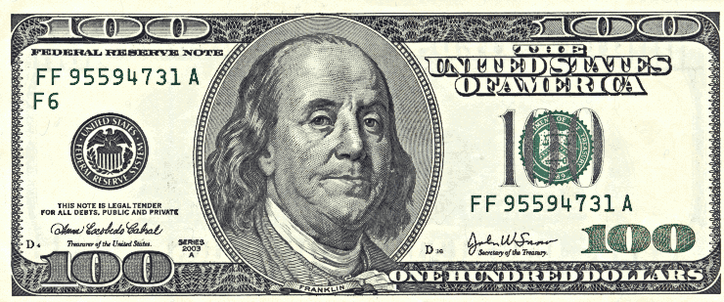

Slide 4
Why Start Early?
Iterative process
Need to get specific information
Time to create overall story or themes
Ability to recover from missteps

Slide 5
Basic Timeline
Discovery
starts
Expert
reports
Pre-trial
Complaint
Response
Depositions
Trial

Slide 6
Starting with the “But For” World
“But For” world is what would have happened absent the breach/tort/infringement
Investigate all types of damages or loss before pigeonholing into legal theories
For plaintiffs, every day is a sunny day in the “But For” world
For defendants, every day is a rainy day in the “But For” world

Slide 9
Components of the Damage Claim
Compensatory damages
Pre- and post-judgment interest
Attorney’s fees
Costs
Punitive damages
Statutory damages

Slide 10
Basic Legal Theories
Lost profits
Out-of-pocket loss
Diminution of value
Disgorgement
Quantum meruit
Price erosion

Slide 11
Time Period
Starting point – limitations apply?
Ending point – in the future?
Discounting – time value of money?

Slide 12
Defenses
Mitigation
Statute of limitations
Consequential
Limitations on liability
New business rule
Economic loss rule

